Slide 1


Slide 2
Application Overview
What is ClassMatez?
What does ClassMatez provide?
Why did we develop ClassMatez?
Notes:
What ClassMatez is – an application to help students meet people and make friends on their courses; users sign up, choose their courses, and can then choose where they want to sit in their lectures based on where other people in their lectures are sitting. Squadz can then be established by students in the same class.
What ClassMatez provides - allows users to establish a friend group within (zones) and across their different subjects (people you may know, which shows users other students who take the same courses as them across multiple subjects) and meet people they may otherwise have not gotten to know. Provides a place for people to meet and context for meeting new people.
Why we developed ClassMatez – We wanted to develop an application that we might use, and we developed it to fix what we perceived as a problem. As students, we are the user base/target audience so can we understand concerns/what is wanted out of the app well.

Slide 3
Design Issues
Social Media API’s
Breadth of coverage – scope of application
Choosing seats – zones
How ‘Squadz’ are formed
Application features – finalising user requirements
Notes:
Social Media API’s – there was some debate over using Social Media API’s for login functionality, but this was dismissed as we wanted to follow our design principle of restricting the amount of information users provided and this would have been too much.
Breadth of coverage – there was debate over how far we would/could extend the scope of the application across the whole of the university – in terms of courses supported, lecture theatres (and their layouts) etc. – and we ultimately came to the decision of covering courses most relevant to us and computer science, as well as the most used lecture theatres which gave us a good general template for layouts.
Seating and zones – this design issue was influenced by our design principle of keeping interaction casual and unrestrictive, leading us to have seats chosen in the form of larger zones, as on a practical level assigned seating cannot be guaranteed as it can’t be assumed that everyone in a course will be on the application.
Squadz; there was some discussion of squadz persisting for users across multiple shared classes, but the decision was made to keep squadz limited to only within one class to keep them inclusive, rather than possibly excluding users who do not share all their classes with others.

Slide 4
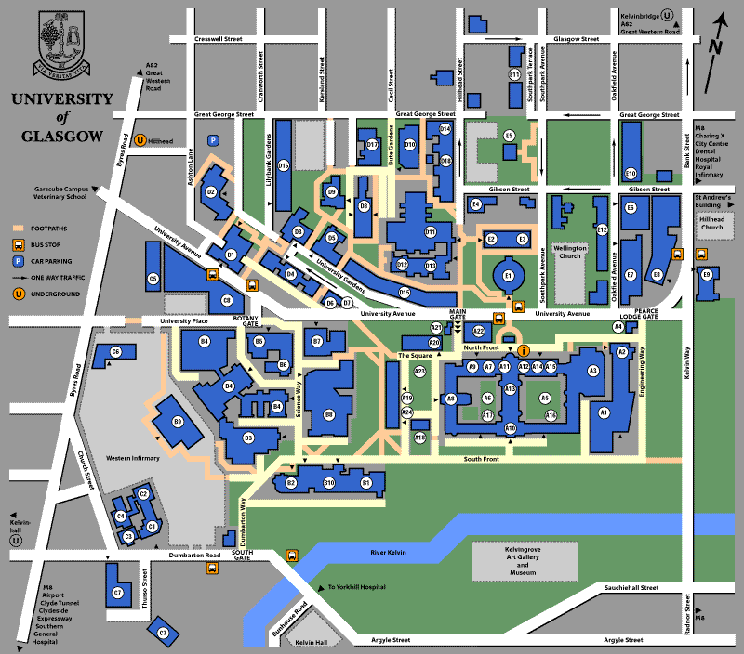
Project Development – Future Development
Routez
Squadz – “Users should be able to form groups within classes (called squadz) spanning multiple zones as well as viewing lists of the existing squadz. These different squadz should be easily distinguishable from one another.”
Notes:
During the project design phase, we discussed the possibility of adding a routez system that would allow users to find other students who took the same classes as them to walk to classes together and plot the best route across campus for them to take. We then abandoned this idea to focus on the other core features of ClassMatez but this would be a feature implemented later in the application’s development.
During the project development we found that we were unable to implement the Squadz functionality described in the user requirements due to the time constraints of the project. As it was a more of an accessory feature rather than a core feature the decision was made not to implement it yet, but ideally it would be the next implemented feature in a future deployment of the application.

Slide 5
Technologies and Team Contributions
List of technologies used – PythonAnywhere, GitHub, JQuery, Django
Team Contributions
Notes:
Carlos talk about how he specifically used Jquery – Area implementation for zones when users choosing where they are going to sit
Team Contributions – All contributed to the creation of the Design Specification, Matthew then created a series of detailed user requirements to help tehh with creation of the database model and establish the data and functions we would need.
Each person then talk about their main contribution.

Slide 6
Demonstration
Notes:
Demo
-Going to demonstrate the core functionality of Class Matez
-Running through from the point of view of a new user; from the landing/introduction page to signing up a new account
-users will input their personal account information (which can be changed at a later time through the account menu) and then choose their classes
-Once their classes have been chosen, they user is taken to the home page where they can view their schedule, suggested friends/people you may know

